Slide 1



Credit Card Fraud Detection

Slide 2
Aim to identify fraudulent transactions from various sensitive components and $ amount
Credit Card Fraud costs have surged to ~$34 billion as recent as 2022
Machine Learning can provide assistance in detecting patterns of fraud
The Problem + Why it is Important
Notes:
One main factor in me choosing to model and classify credit card fraud is because it has a direct impact on consumers like you and me. As a victim of credit card fraud myself, I thought it would be interesting to try and attempt to see how pattern recognition in this sense is done.

Slide 3

Common Models
Current Solutions
Logistic Regression: computationally efficient
Decision Tree: Captures Feature interactions
Random Forest: Handles non-linearity
XGboost: High Accuracy
Generally, banks and credit card companies cross reference transaction records as well as looking at transactional data.
Look at components like amount, IP address, and similar features in this analysis
Notes:
Most credit card companies and banks look at transactional data and other features to recognize a fraudulent transaction, and many utlize AI to recognize these patterns. This is the reason I chose to utilize a neural network to model this dataset, because the advantage this architecture provides is pattern recognition, which is similar to how credit card transactions are marked as fraudulent. More importantly, fraud patterns grow different each year, which makes this choice all the more important. Typically, simple classification models like Logistic Regression, or feature recognition models like Random Forest and Decision Trees are utilized to model credit card fraud in machine learning. Like these model choices, NN also can idenitfy non-linear relationships and tend to be prone to overfitting. Still, my choice of a Neural Network remains justified because it can more easily recognize complex patterns.

Slide 4
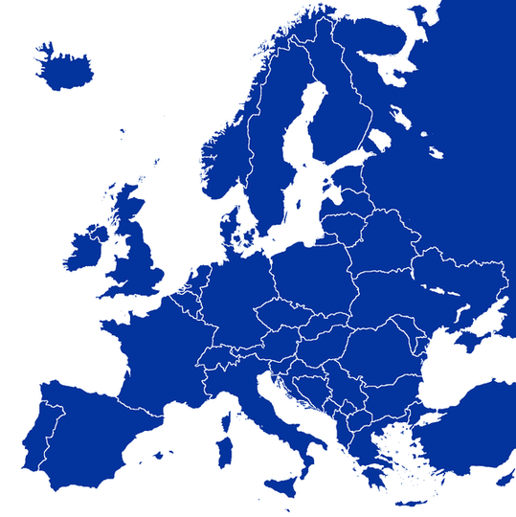

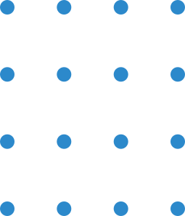
Data
Kaggle - Credit Card Fraud Dataset
Transactions from European Customers in 2013
~ 285,000 observations
31 features
V1 - V28 : Principal Components ( redacted for privacy)
Class : Not Fraud (0) and Fraud (1)
Time: # of secs between transaction and 1st transaction in dataset
Amount: Transaction amount (in Euros)

Slide 5
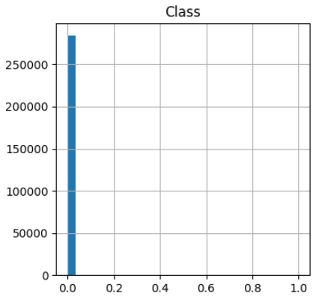
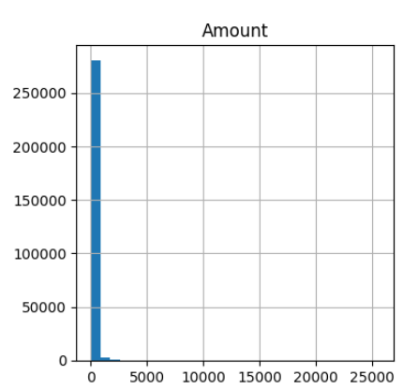
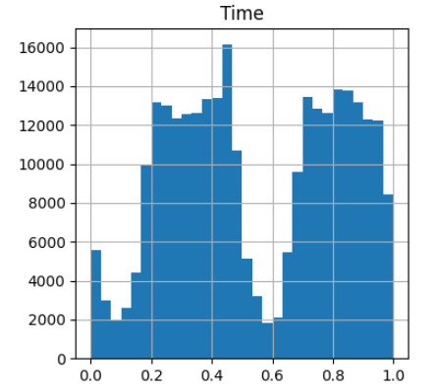
Data Exploration
Data is highly imbalanced w/ fraudulent transactions.

Slide 6
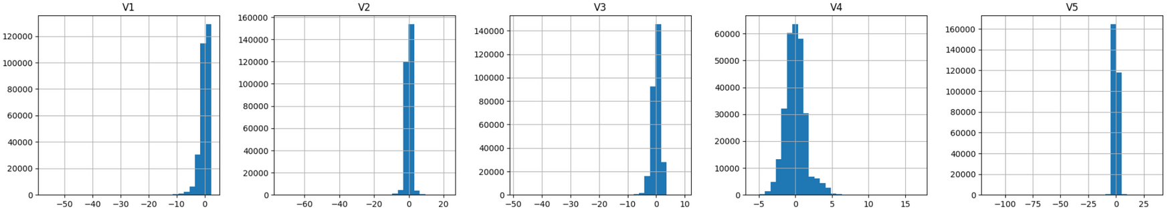
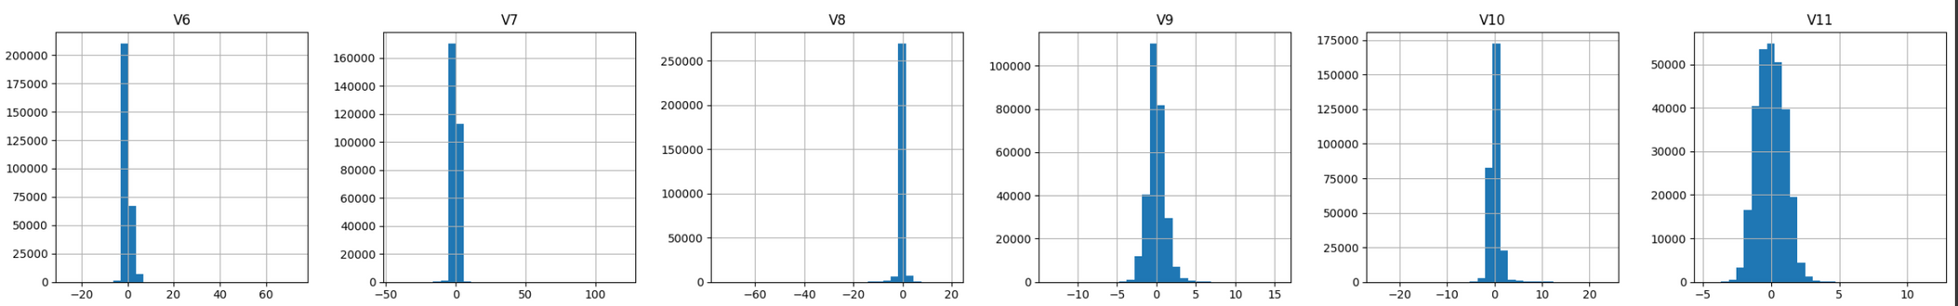
Data Exploration
V1-V28 have normal distributions

Slide 7
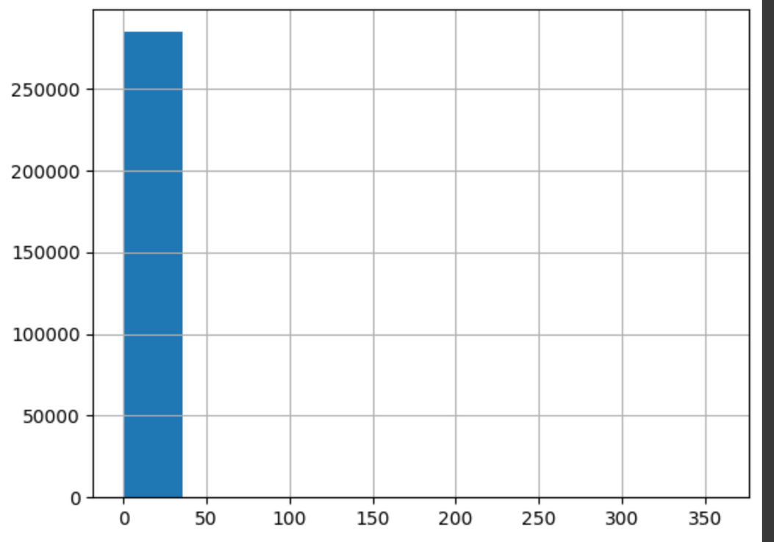
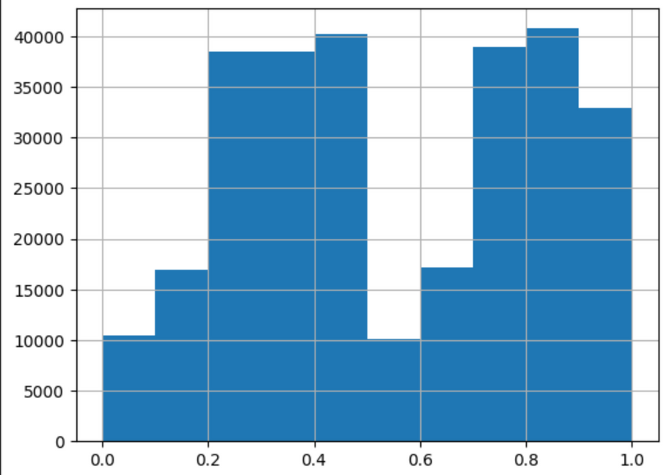
Data Processing
Amount
Time

Slide 8
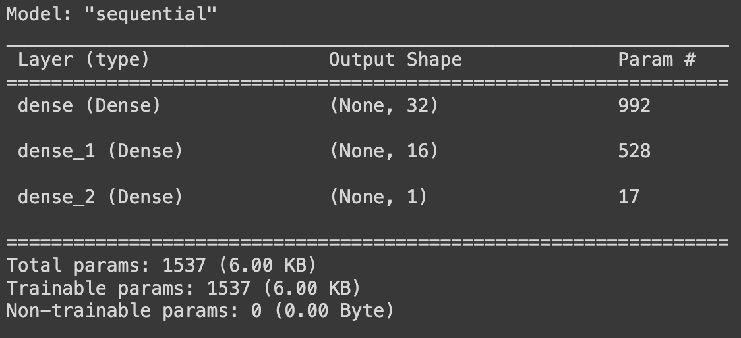
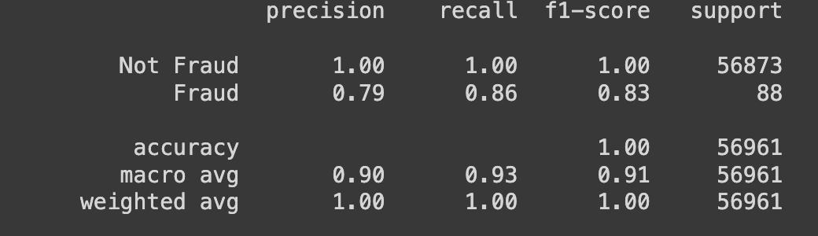
Model:
First Model Iteration + Results
Basic Neural Network
Input Layer
Hidden Layer
Output Layer
Indication of Overfitting --
Results:

Slide 9
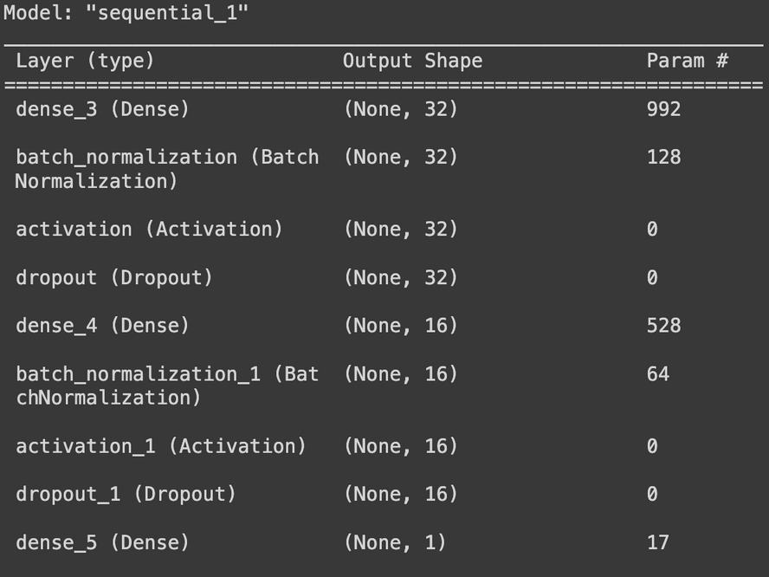
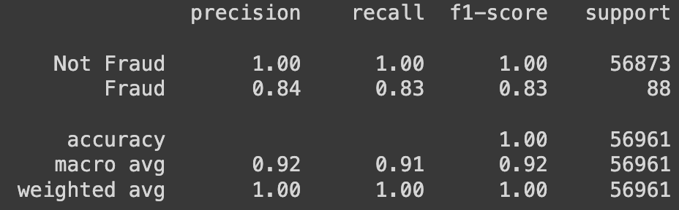
Model:
2nd Model Iteration + Results
Updated Neural Network
Input Layer
Hidden Layer
Batch Normalization
Activation Layer
Dropout
Output Layer
Slight Decline in Test loss score and validation Fraud Precision
Results:

Slide 10
Future Improvements
Utilize Feature learning
Hyper Parameter Tuning

Slide 11
References
https://www.sofi.com/learn/content/how-credit-card-frauds-are-caught/
https://medium.com/analytics-vidhya/credit-card-fraud-detection-c66d1399c0b7
https://www.kaggle.com/datasets/mlg-ulb/creditcardfraud

